Slide 1
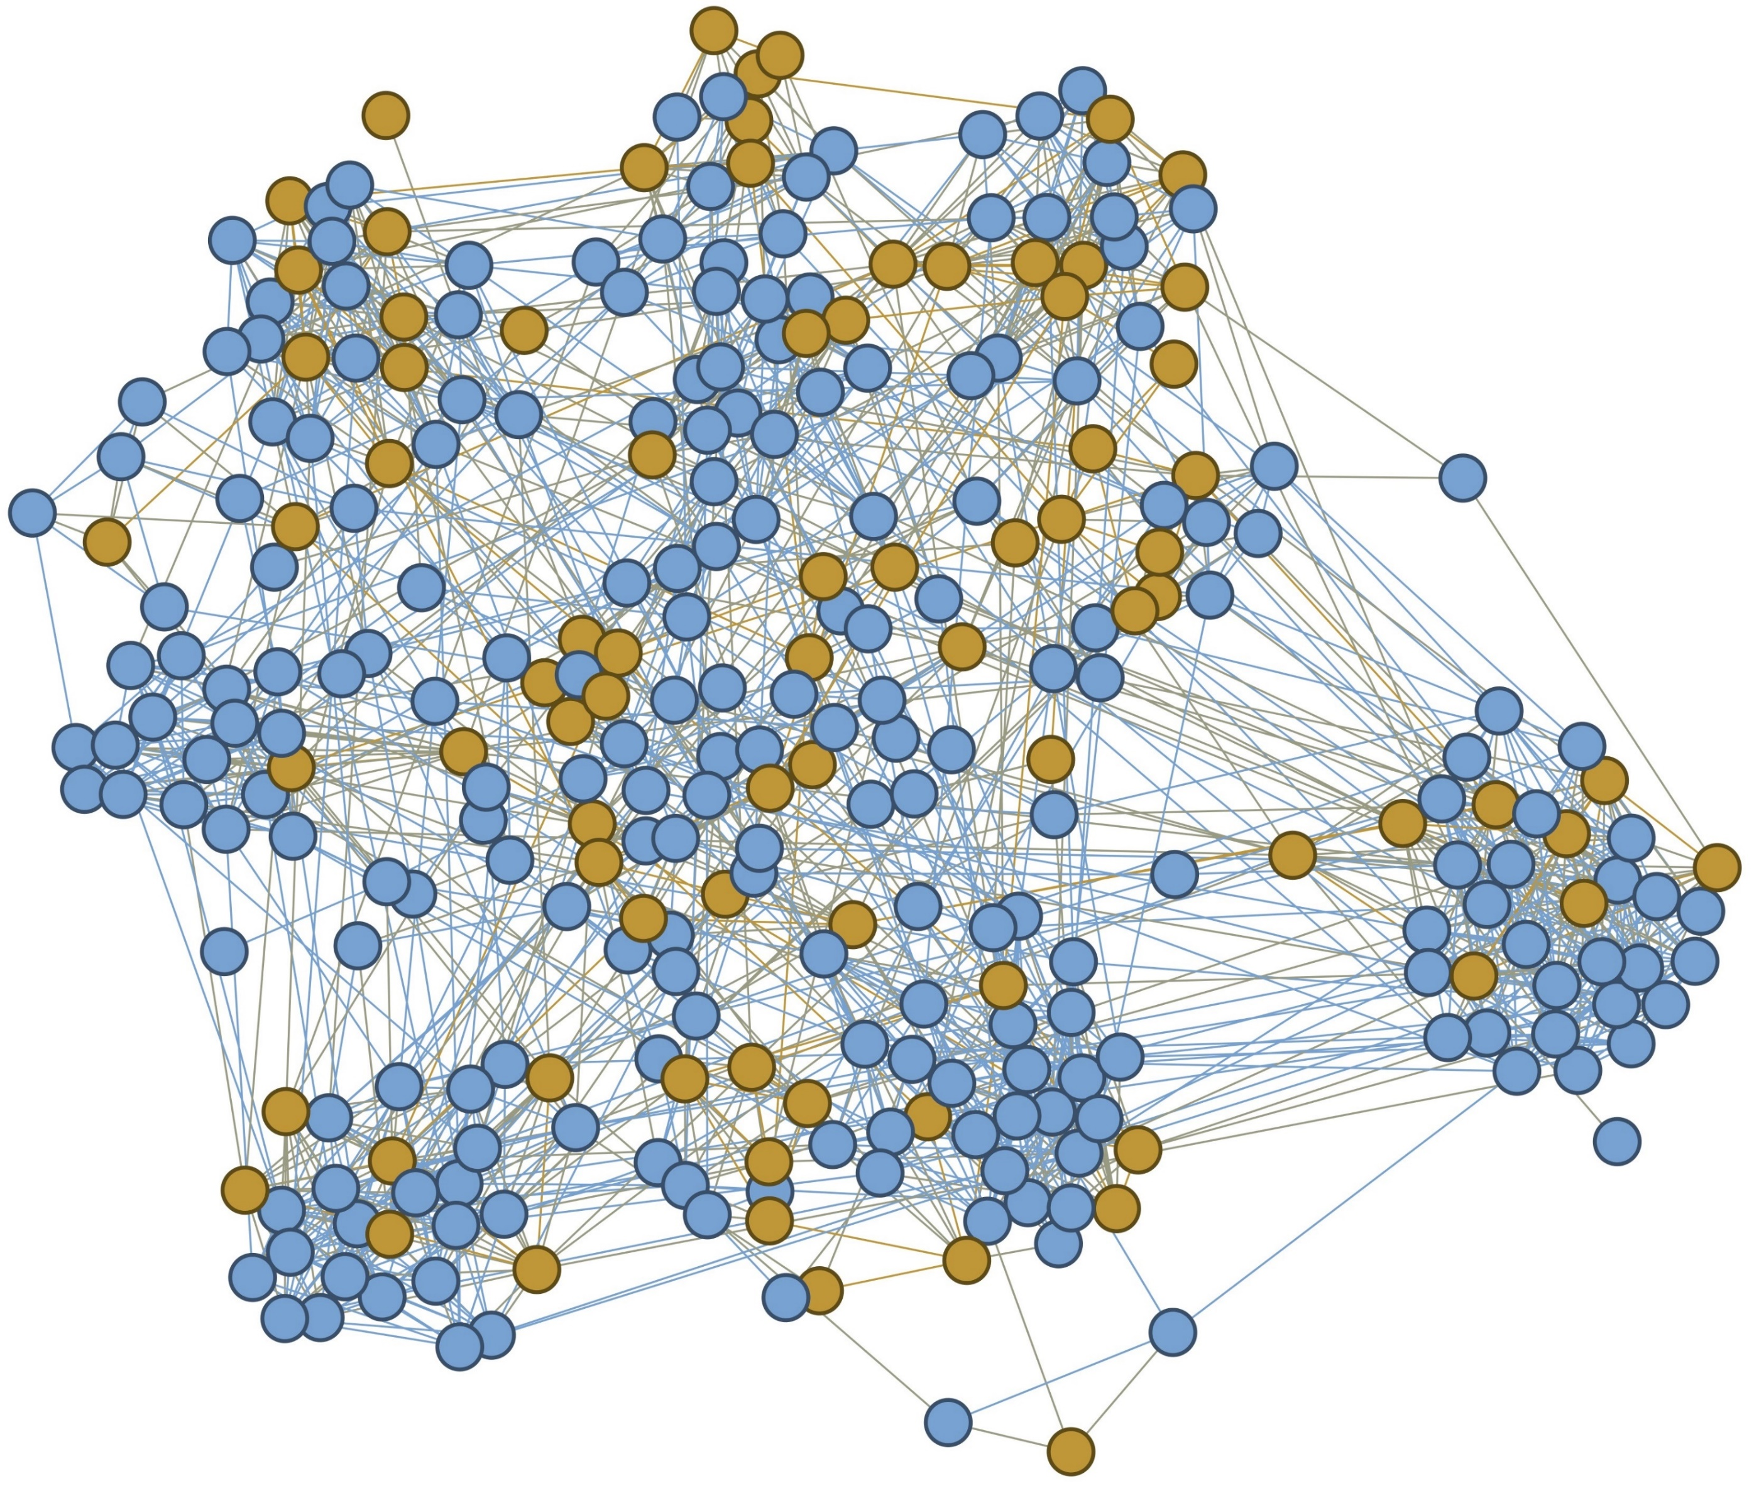
Dynamics of Smoking
Lecture with Computer Exercises:
Modelling and Simulating Social Systems
Notes:
Inhalt: Welcome to our presentation

Slide 2
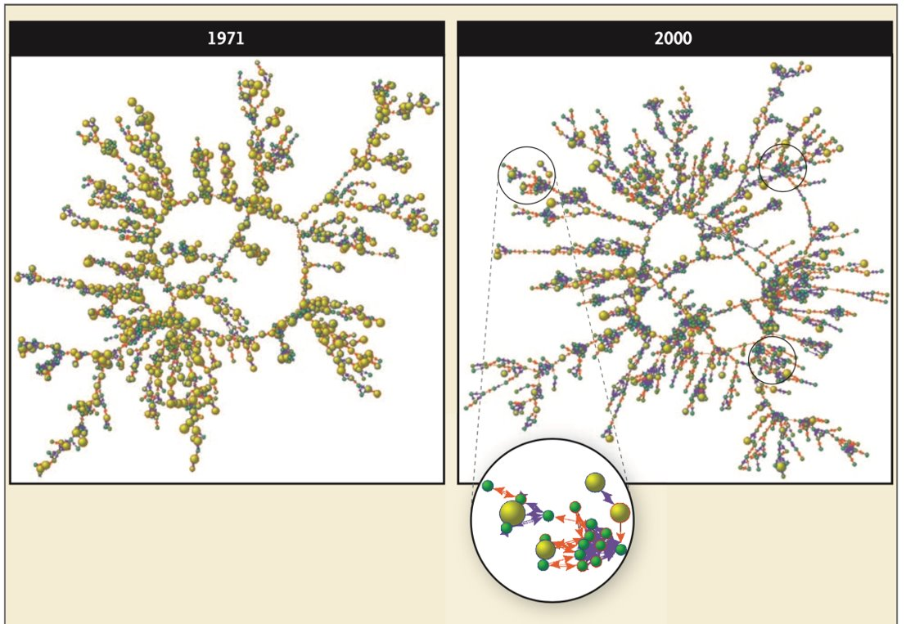
Paper by Christakis and Fowler
Data from Framingham Heart Study
Formation of groups
Influence by the cessation of a family member or a close friend
Nicholas A. Christakis and James H. Fowler. “The Collective Dynamics of Smoking in a Large Social Network”
In: New England Journal of Medicine 358.21 (May 2008), pp. 2249–2258.
Notes:
Inhalt:
- We based our model on paper by Christiakis and Fowler about smoking
- They looked at the Framingham Heart Study, a long time study that collected the health statuses of over 12’000 participants over 30 years.
Christiakis and Fowler found that groups of smokers and non-smokers form over time
The society of the paper can be seen here.
Smoking cessation of a familiy member or a close friend had a positive impact on the smoking behaviour of a person

Slide 3
Goals
Reproduce the results found by Christakis and Fowler
Investigate the formation of groups in our society
Observe the time evolution of our model
Comparison to reality
Notes:
Inhalt:
Our goal was to build a model that can reproduce the result of Christiakis and Fowler
Investigate how our model behaves

Slide 4
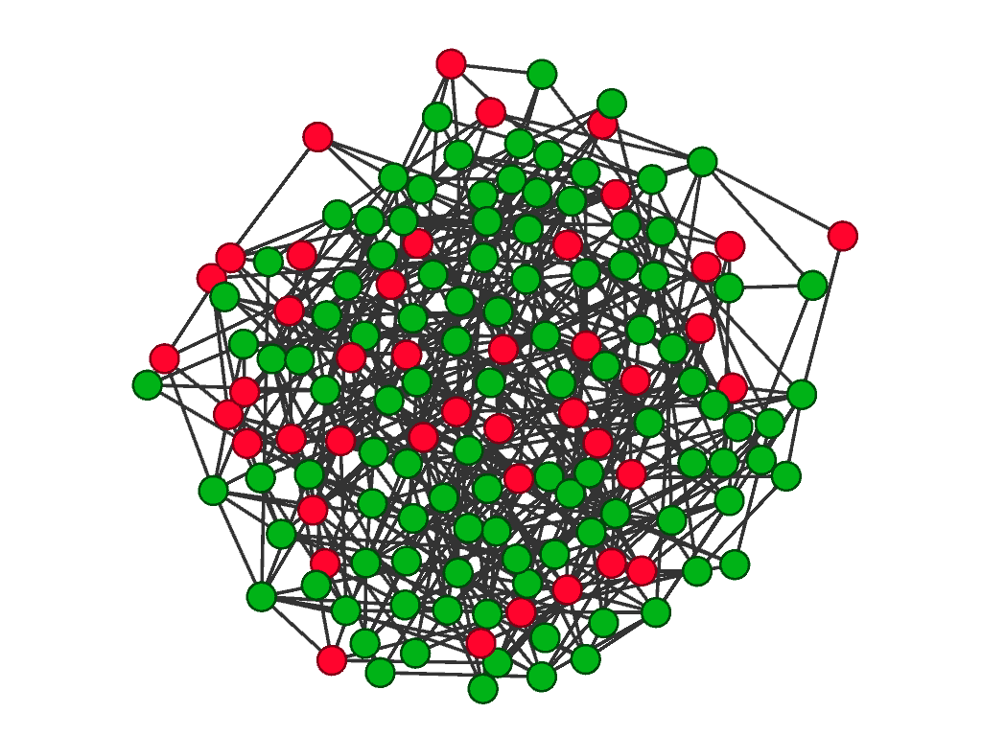
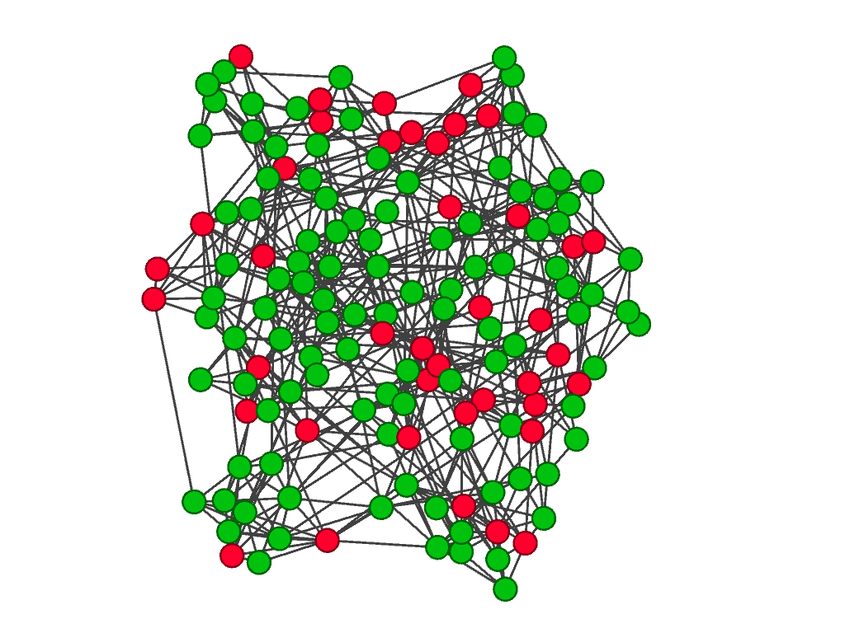
Our model – Creation of the Society
Agent based approximation of a real social network
Random graph Our graph
Notes:
Inhalt:
We wanted to simulate the society of the study and choose to implement an agent based model
Our society consisted of a graph with 300 to 1000 nodes that represented agents.
That the network resembles a real social network, we created it so that it had a reasonable clustering coefficient of 0.25

Slide 5
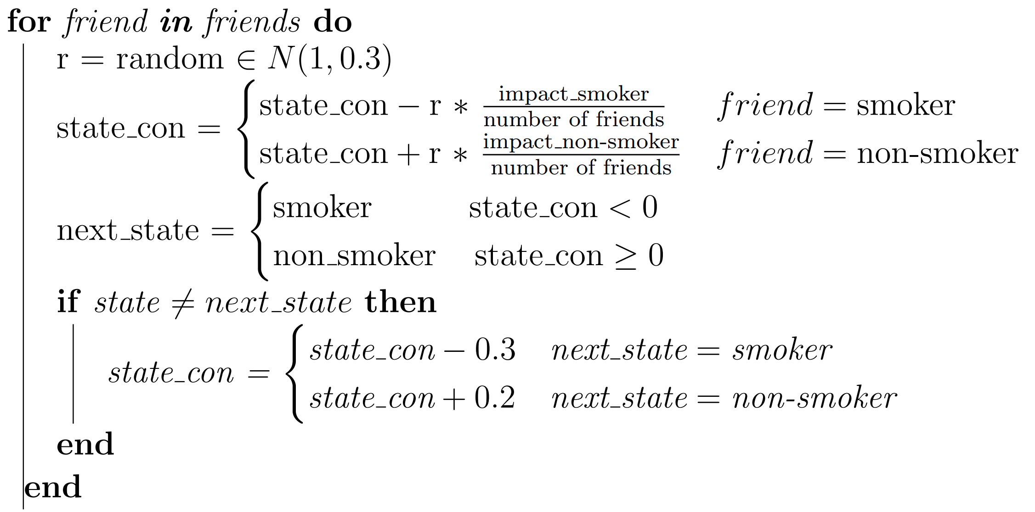
Our model – Simulation
Notes:
We simulated 30 years, in every year each agent updates it status based on its environment
The floating variable changes depending on the smoker and non-smoker friends
The influence of smokers and non-smokers can be controlled with the parameters impact_smoker and impact_non_smoker

Slide 6
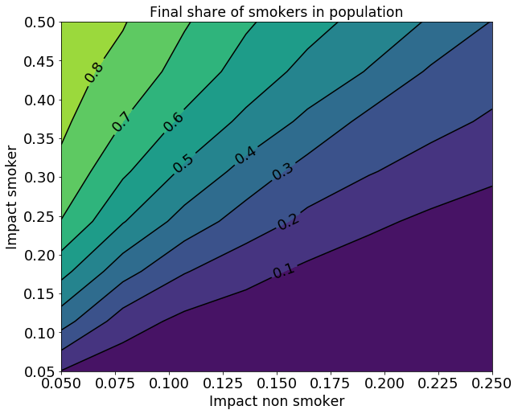
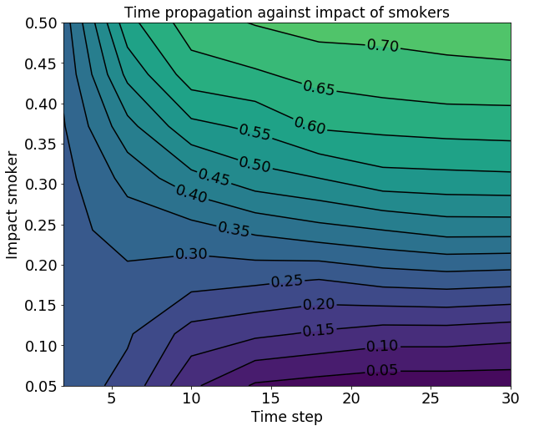
Results –Impact Parameters and Time Evolution
Notes:
Inhalt:
First we run our simulation on a grid of different values of the paramter impact_smoker and impact_non_smoker
For this we plotet the final percentage of smokers after 30 years to see how our model behaves
We also looked at the time propagation for different values of the parameter impact_smoker

Slide 7
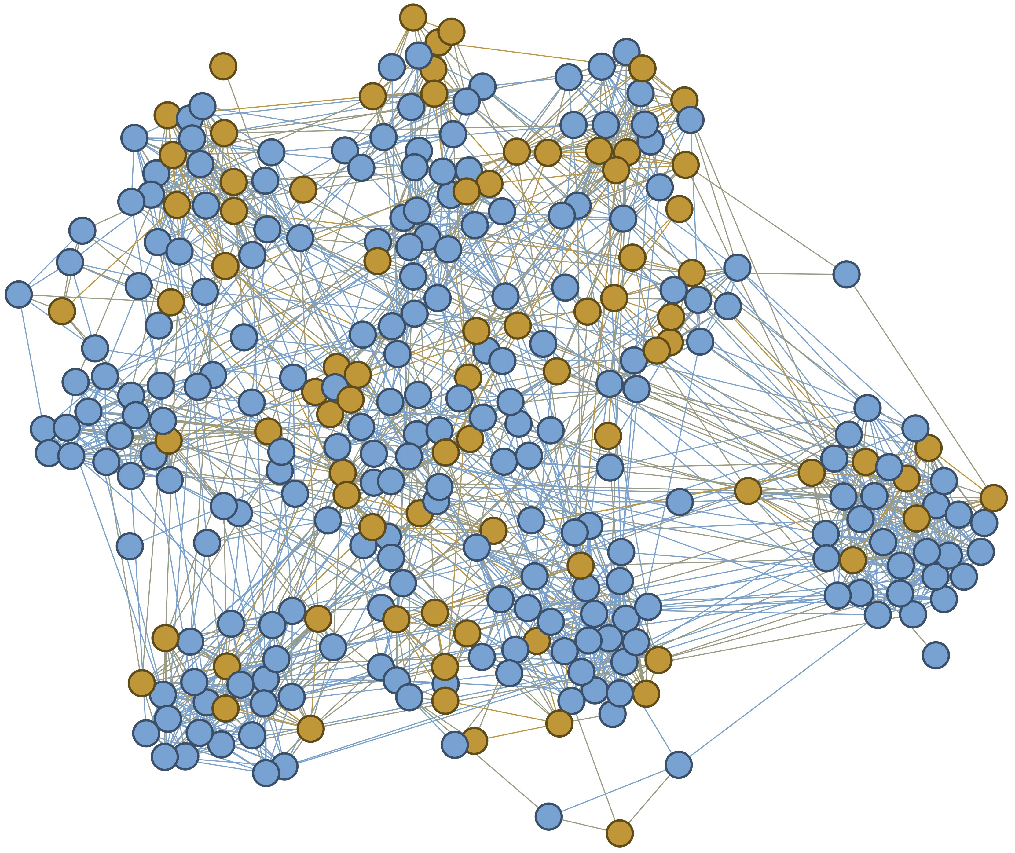
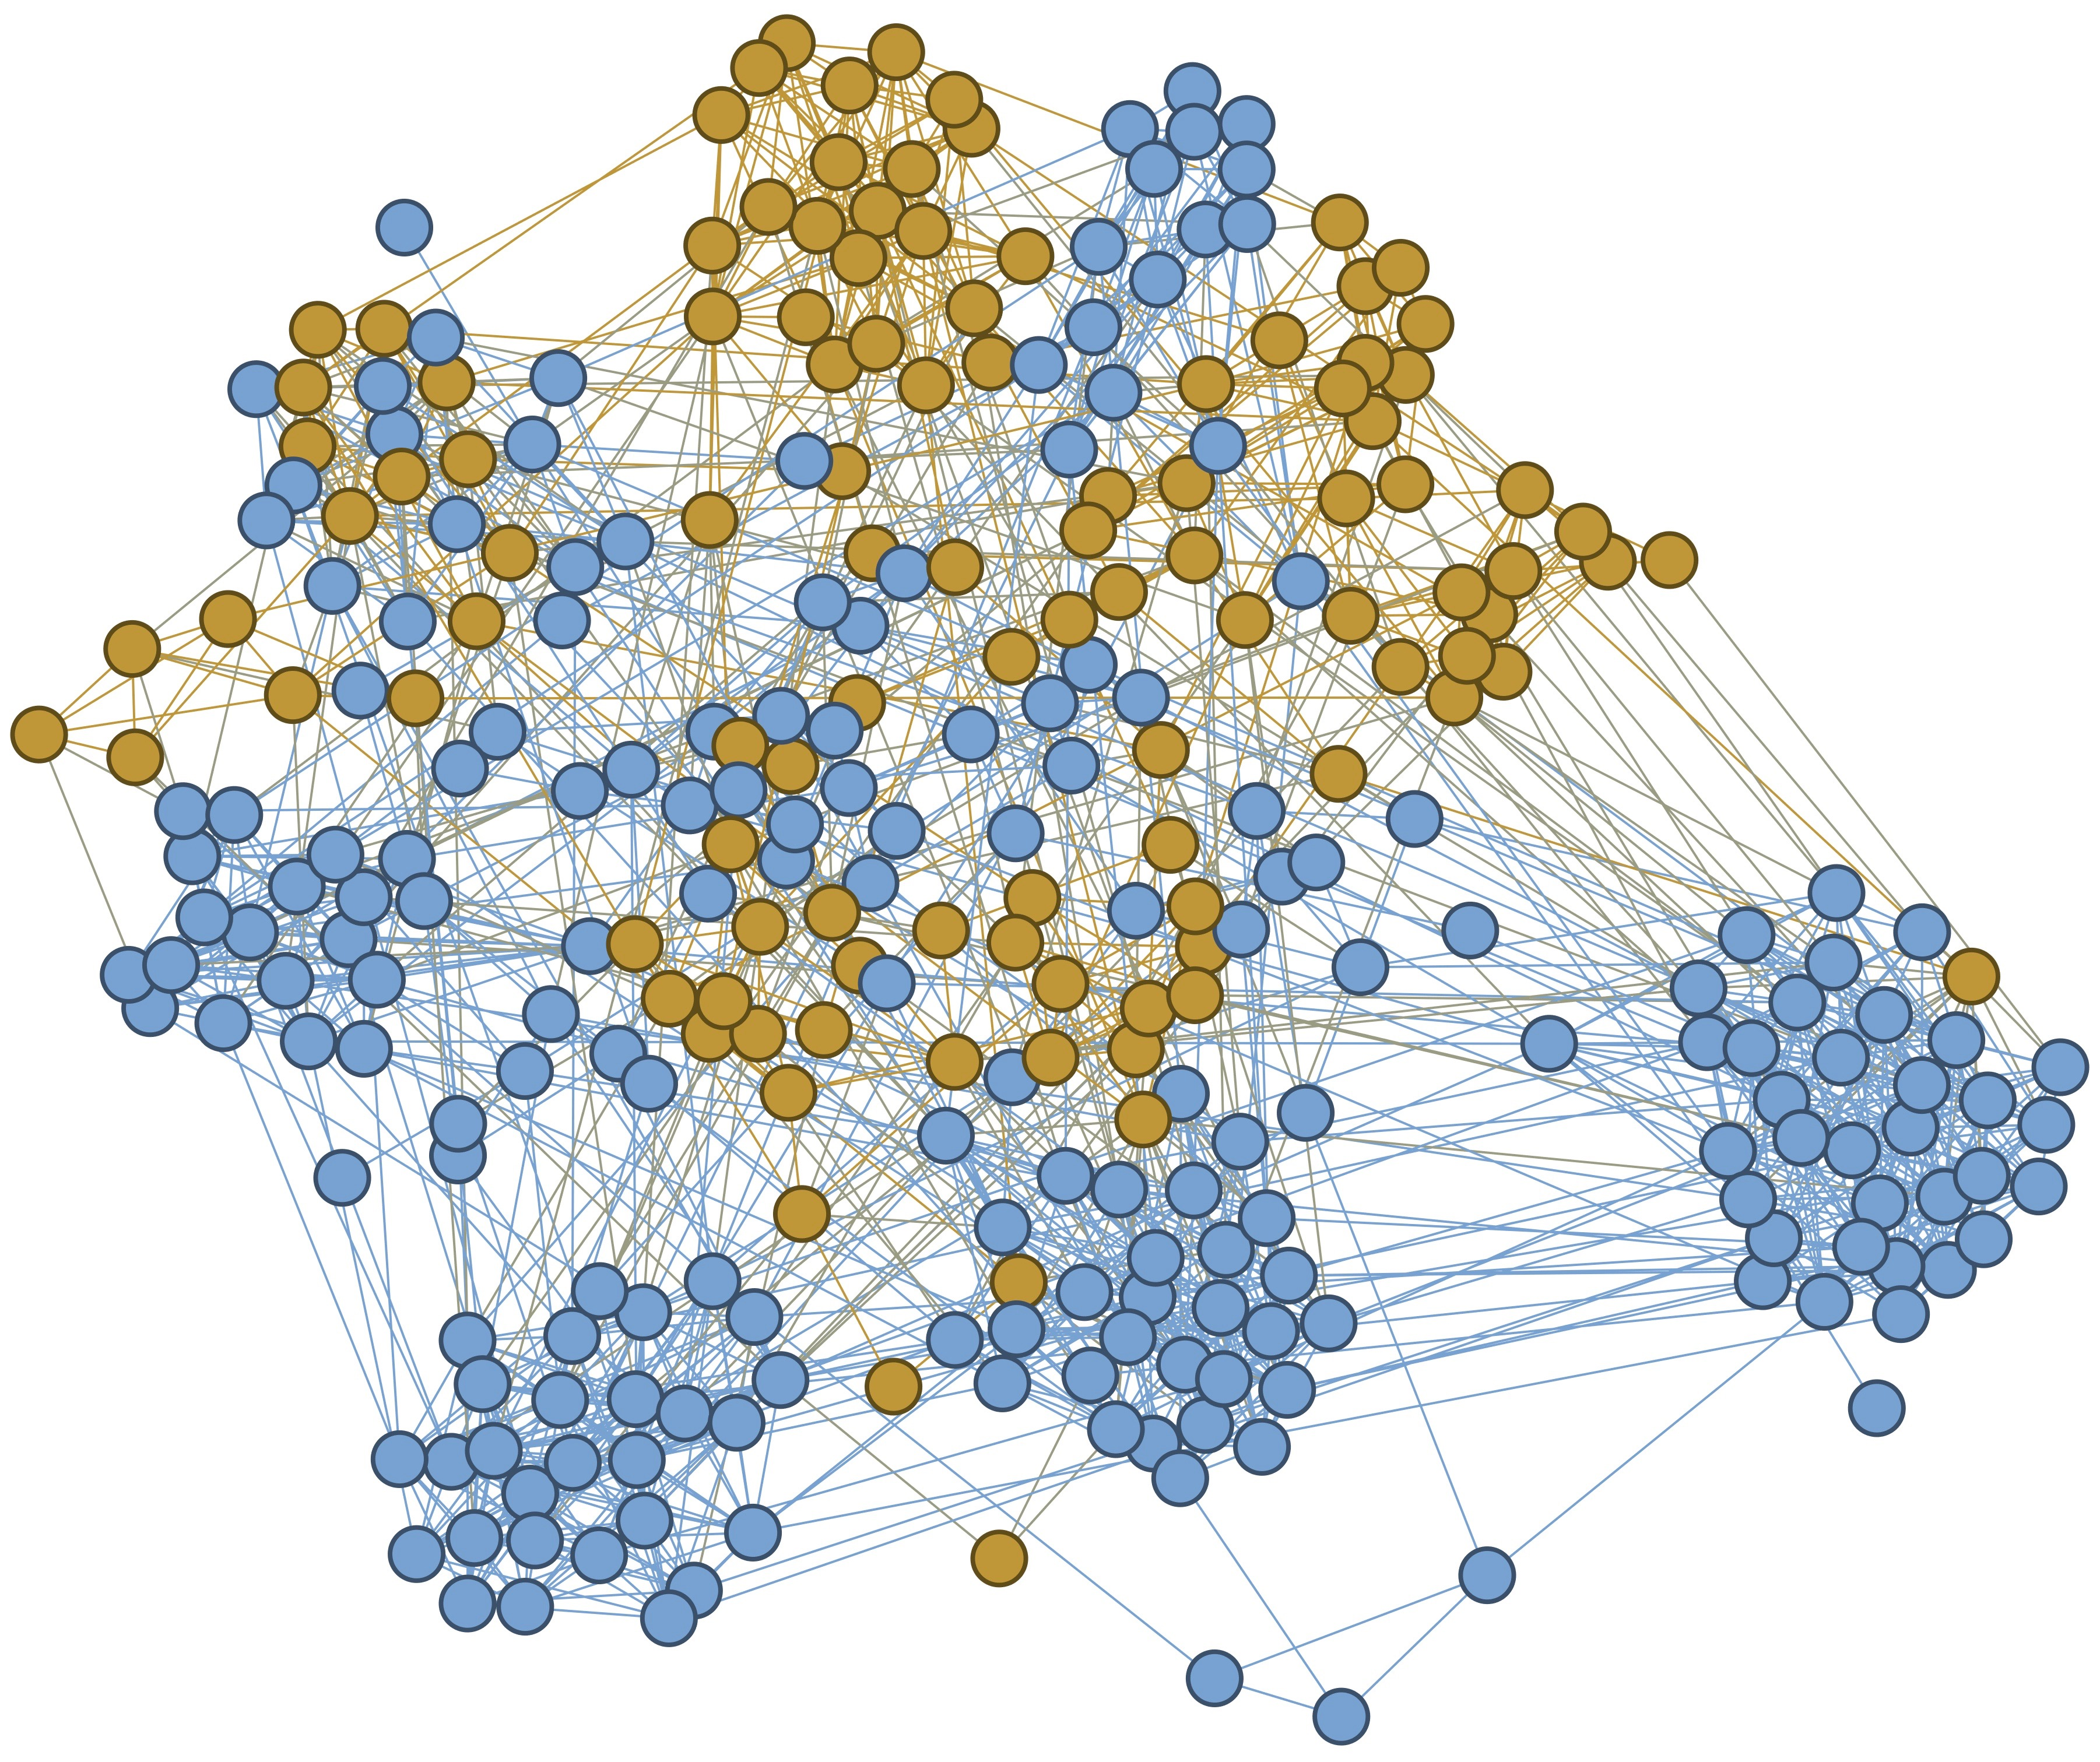
Results – Formation of groups
initial state final state
Notes:
Inhalt:
-Like in the paper by Christiakis and Fowler we found that groups of smoker and non-smokers form in our society

Slide 8
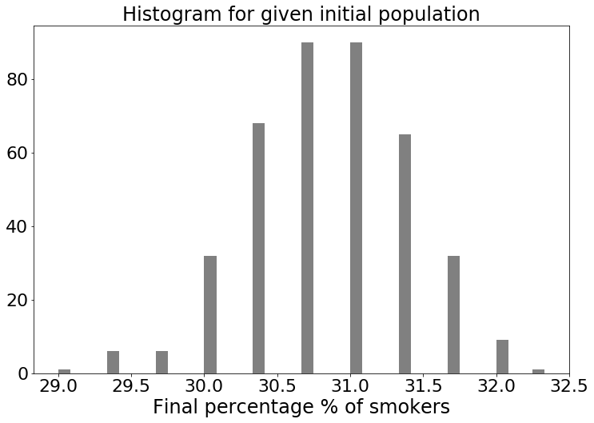
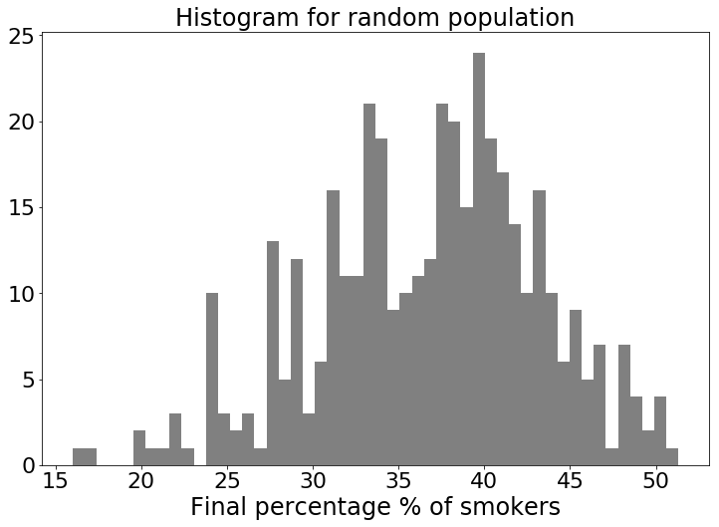
Stability of our model
Notes:
Inhalt:
To find out how stable our model is, we run 400 simulation with the same initial population but with different random numbers. We found a small standard deviation in the final percentage of smokers of 0.6 %.
When we additionally created a new initial population in every simulation, the results varied very much an had a standard deviation of 6.6%
We see that the final shore of smokers in our simulation not only depends on the initial share but also on the way the agents are connected.

Slide 9
Summary
Model can not reproduce the results of Christakis and Fowler quantitatively
Qualitative phenomena like the formation of groups and the positive influence of friends quitting can be observed
Notes:
Inhalt:
We saw that our model can not be used to predict the percentage of smokers of a society in the future.
Many qualitative statements of the paper could be reproduced

Slide 10
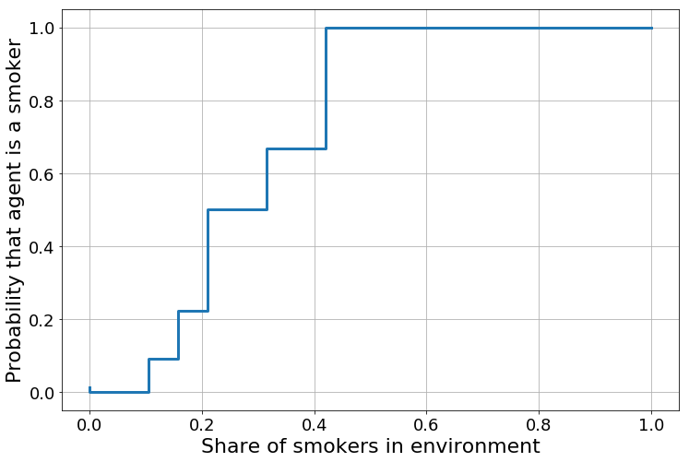
Results – Influence of Environment
Notes:
Zeigen wir wenn genügend Zeit bleibt.
Inhalt:
-To find out how the share of smokers in the environment of an agent influences his probability of being a smoker, we plotet the two quantities against each other.
-We see that for very low and very high percentages of smokers in the environment our model under and over estimates the probability.

